Slide 1



Tiffany Kinney Machine Learning August 2024
Pleasant Predictions with Climate Wins:
Harnessing Machine Learning to Forecast Weather

Slide 2


Introduction
ClimateWins wants to assess available tools for predicting weather in mainland Europe. ClimateWins believes that increases in extreme weather events, like those of the two decades, could be predicted and planned for using tools such as machine learning.
Objective: Use machine learning to help predict the consequences of global climate change.
Data Source:
Collected by the European Climate Assessment & Data Set project from 18 different weather stations across Europe from the 1960 to 2022.

Slide 3
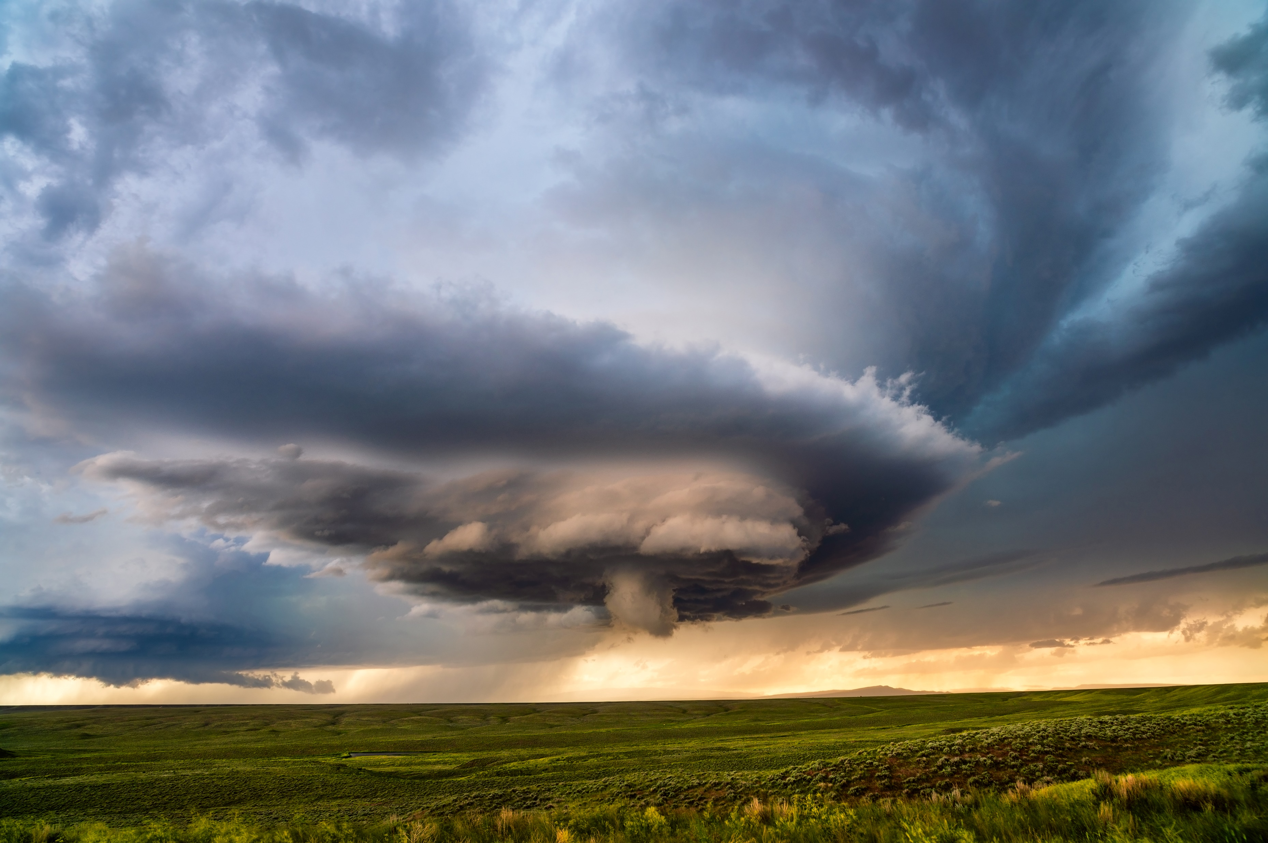

Hypotheses
We can predict future temperature increases using a linear model & historical weather data.
“Pleasant day” weather may be regional. Different groups of locations will follow patterns relevant to their typical weather an clustering them in a logical way before analysis will yield more accurate results.
Algorithms can more accurately predict “bad” weather days because those have more objective measures.

Slide 4
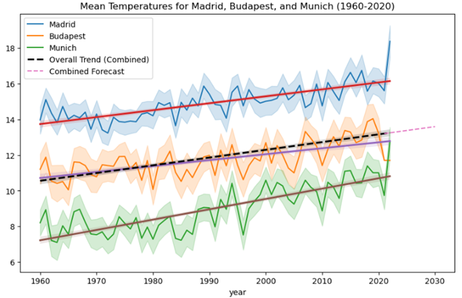
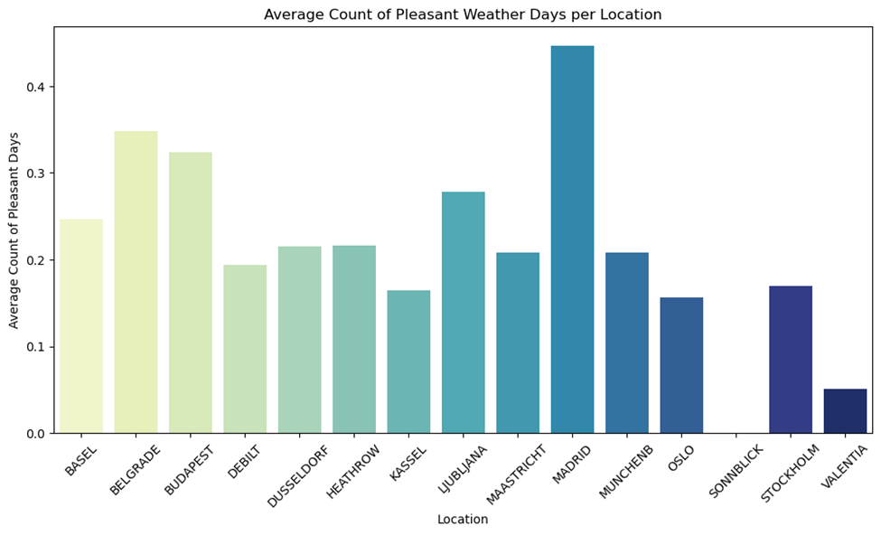
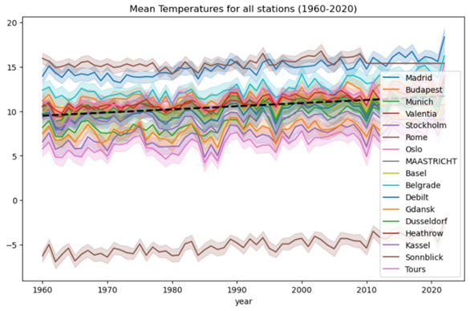
Data Exploration
Trend lines show that temperatures appear trending upward at all locations.
Sonnblick mean temperatures are considerably lower than all other stations, making it an outlier that can potentially skew analysis.
Looking at the average number of pleasant days a year, Sonnblick has NONE, so it will behave differently from locations with variable nice weather in the analysis.

Slide 5
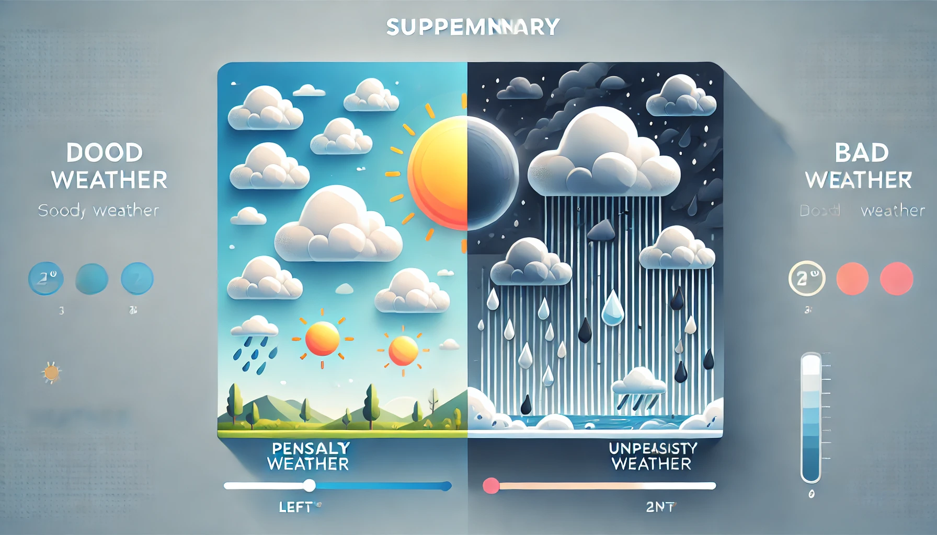
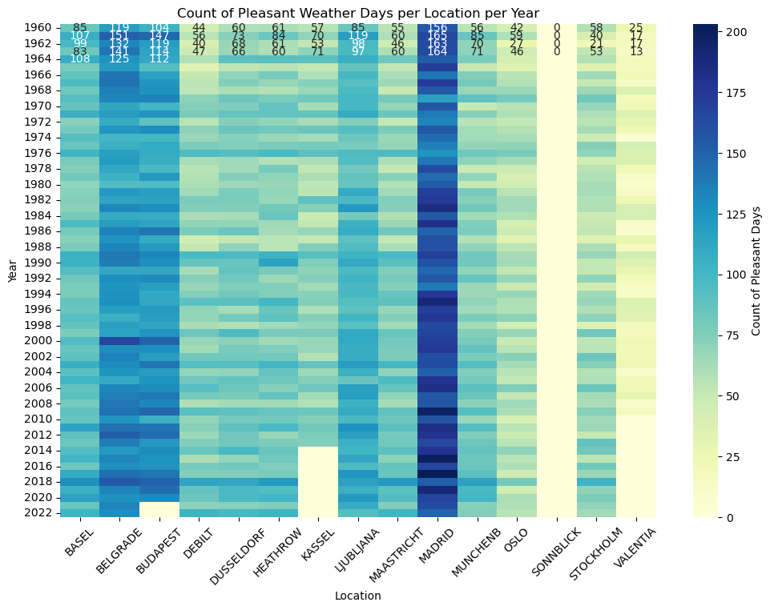
Data Preparation
Data Preparation
Other than Sonnblick not having any pleasant weather days, there are also three stations (Gdansk, Roma, Tours) with no pleasant weather data that should be dropped before analysis.
Madrid and Oslo are at different ends of the temperature and number of “pleasant days” spectrum, so examining what factors are associated with good or bad weather will help guide data handling and understanding.
Madrid is the opposite of Sonnblick, with almost constant pleasant weather, which could make it an outlier on the other end of the spectrum.

Slide 6
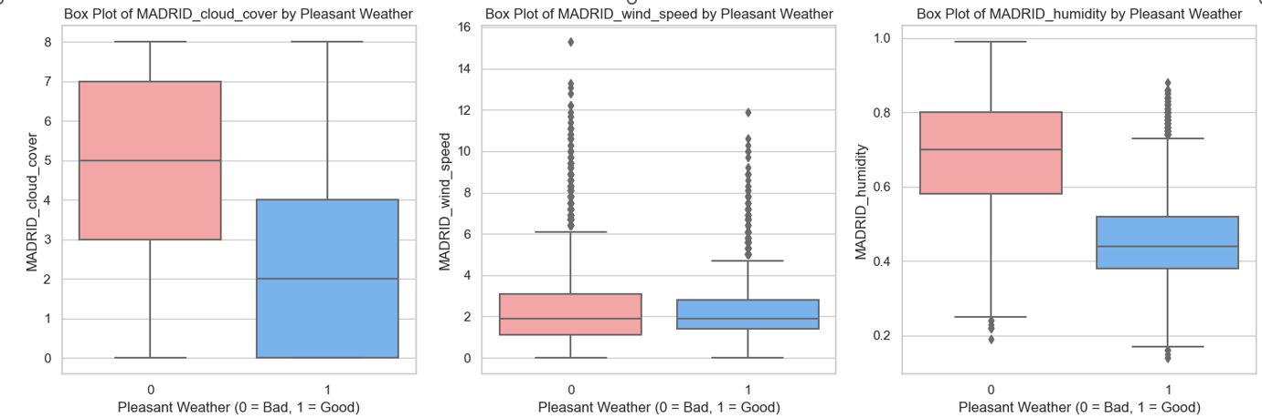
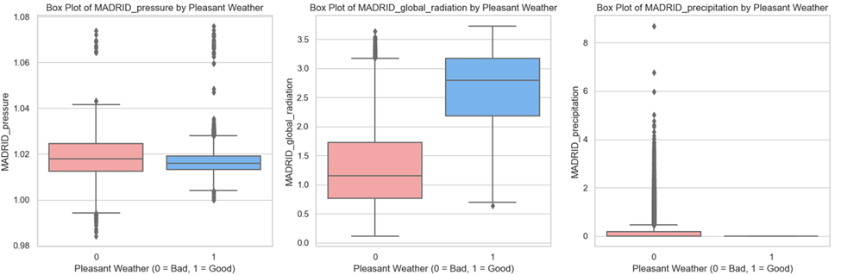
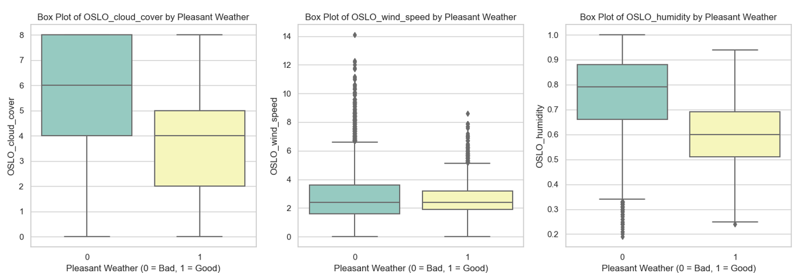
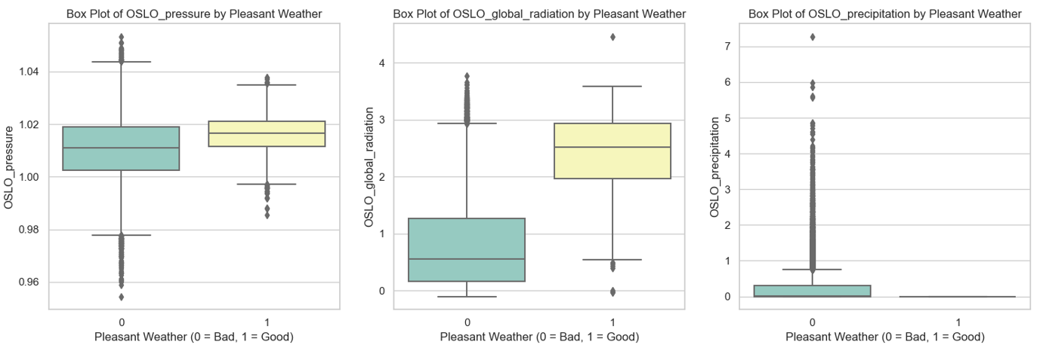

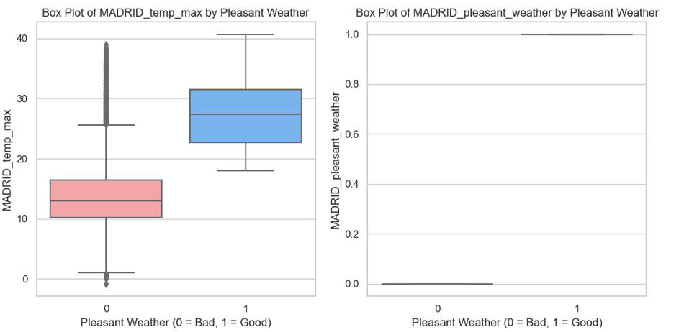
Data Exploration
Exploring what weather variables are associated with pleasant weather in Madrid and Oslo

Slide 7
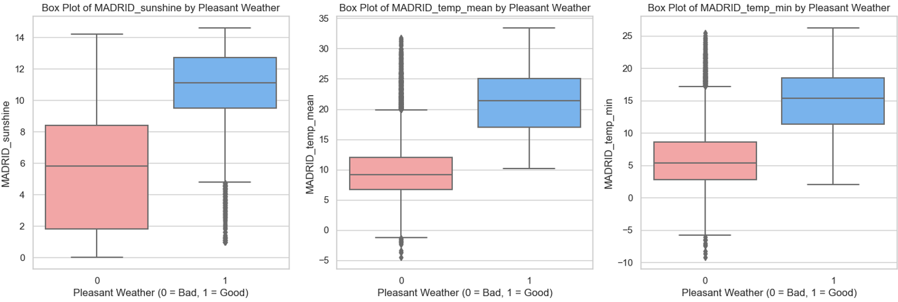
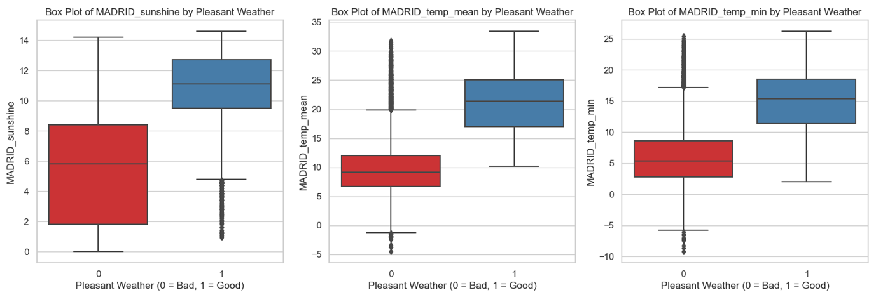
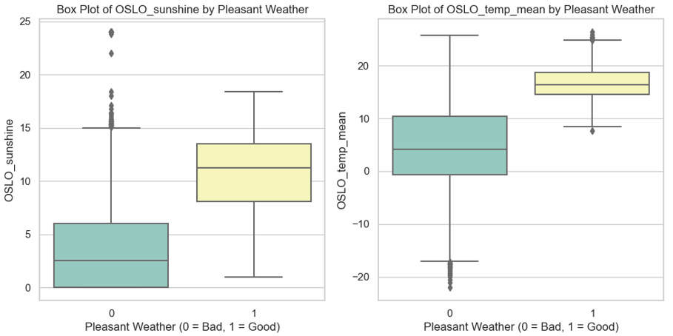
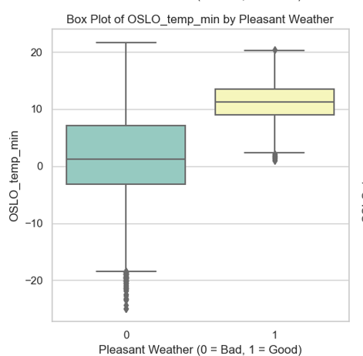
Data Exploration
Even though the exact numbers vary, weather variables have the same relevant relationship for pleasant and unpleasant days, so scaling should be beneficial.

Slide 8
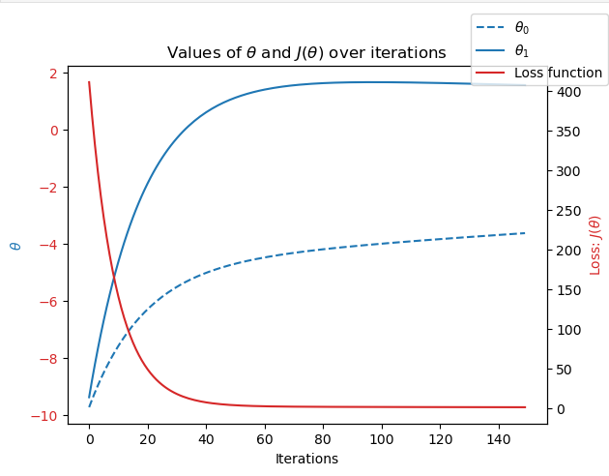
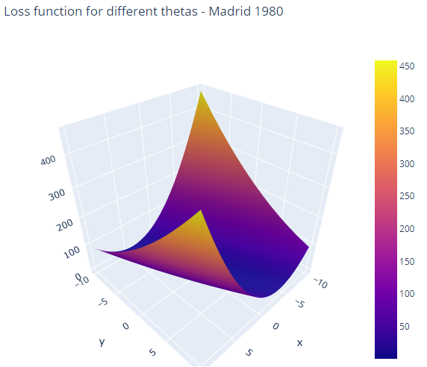
Data Considerations
Data Optimization
Gradient Descent was applied to find the local minimum and optimize the model.
Loss function shows the difference between the predicted and actual weather data.
Data Bias
Location Bias: Data was collected by European Climate Assessment & contains information focused on Europe and the Mediterranean, so may not be applicable to the rest of the globe.
Temporal Bias: Collection began in 1800s and much has changed. Data taken from too wide or too narrow of a time frame may be misleading.
Human Bias: Pre-existing biases in data can be amplified by ML models, leading to inaccurate predictions and decisions. Biased outcomes can perpetuate inequalities and misinform strategies.
Madrid 1980

Slide 9







Algorithms
Accuracy
K-Nearest Neighbor (KNN):
An instance-based algorithm that works by comparing distances between nearby data points to determine which group each point belongs to.
The average accuracy across locations is ~88%.
The accuracy for predicting bad weather at Sonnblick is 100% accurate, may represent poor model fit.
Artificial Neural Network (ANN):
Consists of connected nodes organized into layers that mimic the behavior of a biological system. Computes an output based on a combination of inputs X weights.
Accuracy of ANN, Training Set: 60.8%
Accuracy of ANN, Test Set: 58.4%
( 3 layers (45,35,25) 2700 max iterations tolerance: .000001)
Decision Tree Model
Allows for visualization of how a supervised learning algorithm leads to specific outcomes. Composed of root, decision, and leaf nodes that narrow specific outputs.
Training Accuracy Score: 60.25%
Testing Accuracy Score: 63.25%
The decision tree is too deep and complex to take anything meaningful from in its current state and needs to be pruned.

Slide 10
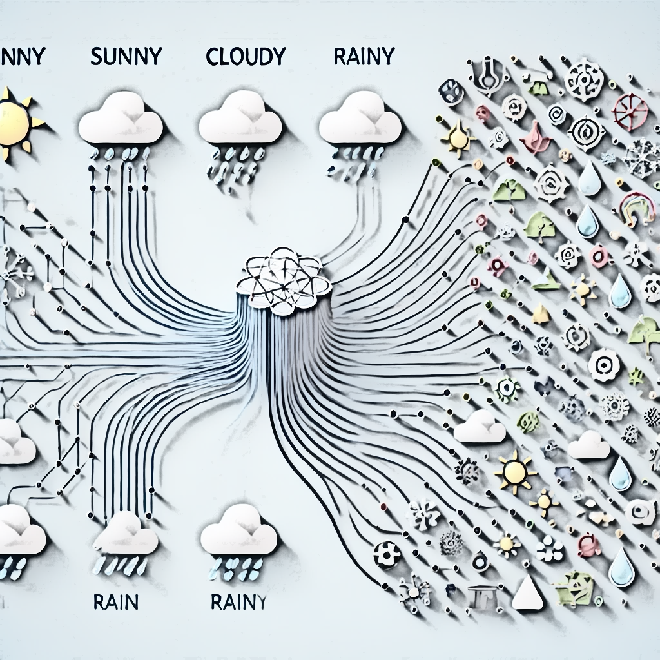
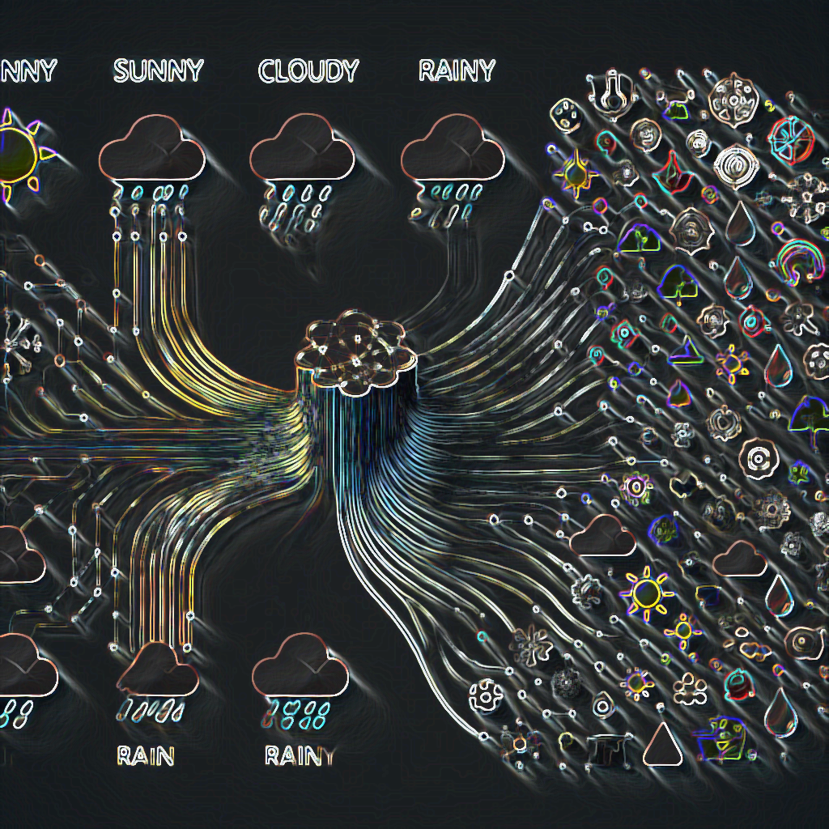
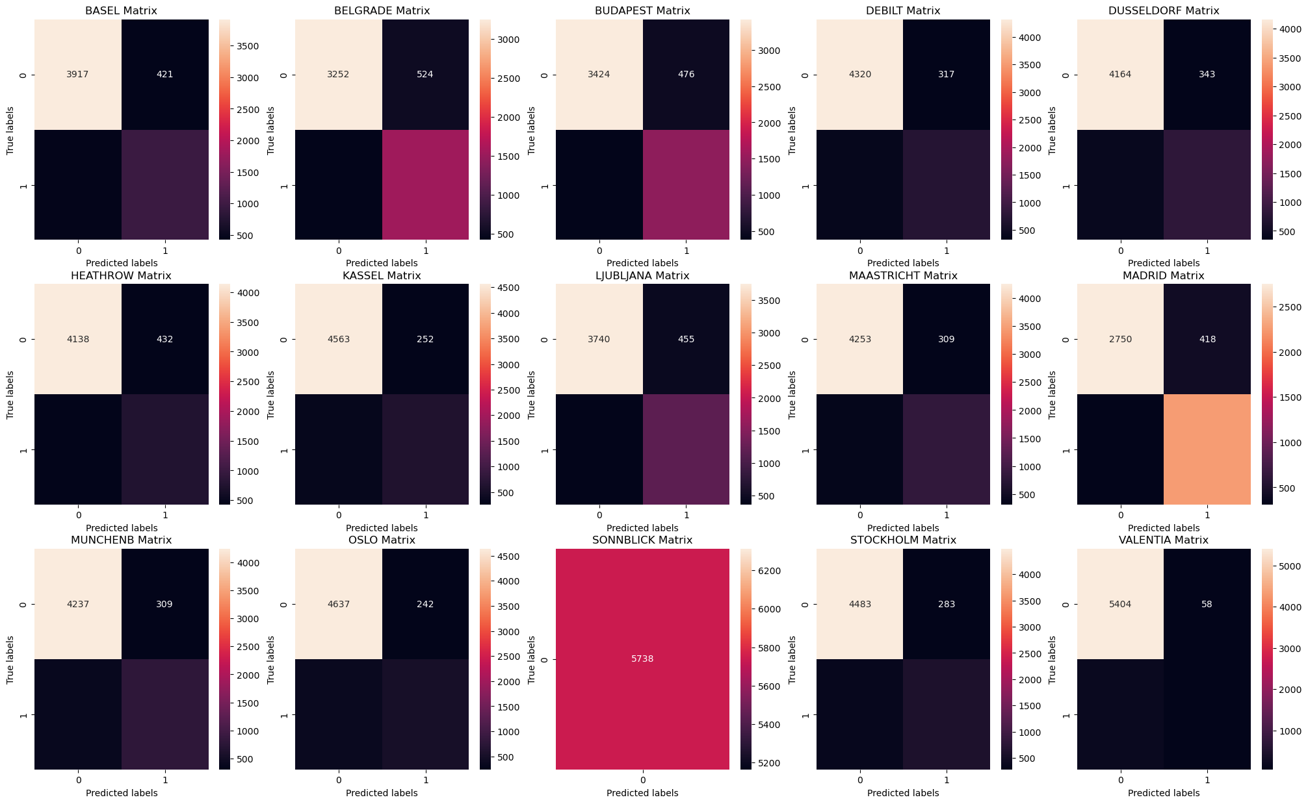
Supervised Learning Methods: KNN
Instance-based algorithms:
Classify data based on the similarity between data points and organize it into patterns based on different attributes.
K-Nearest Neighbor:
An instance-based algorithm that works by comparing distances between nearby data points to determine which group each point belongs to.
Confusion Matrices KNN
The average accuracy across locations is ~88%.
The accuracy for predicting bad weather at Sonnblick is 100% accurate since it has no pleasant days in the data.
Madrid had the most pleasant weather days and has the best prediction of pleasant weather.
Notes:
Location
Correct Positives
Correct Negatives
False Positives
False Negatives
Accuracy Rate
0
BASEL
960
3909
429
440
0.848554
1
BELGRADE
1536
3234
542
426
0.831300
2
BUDAPEST
1464
3430
470
374
0.852910
3
DEBILT
743
4316
321
358
0.881666
4
DUSSELDORF
815
4149
358
416
0.865110
5
HEATHROW
752
4143
427
416
0.853085
6
KASSEL
638
4580
235
285
0.909376
7
LJUBLJANA
1158
3740
455
385
0.853608
8
MAASTRICHT
835
4248
314
341
0.885849
9
MADRID
2285
2749
419
285
0.877309
10
MUNCHENB
799
4226
320
393
0.875741
11
OSLO
528
4625
254
331
0.898048
12
STOCKHOLM
609
4490
276
363
0.888637
13
VALENTIA
77
5399
63
199
0.954339
Average
0.876824

Slide 11
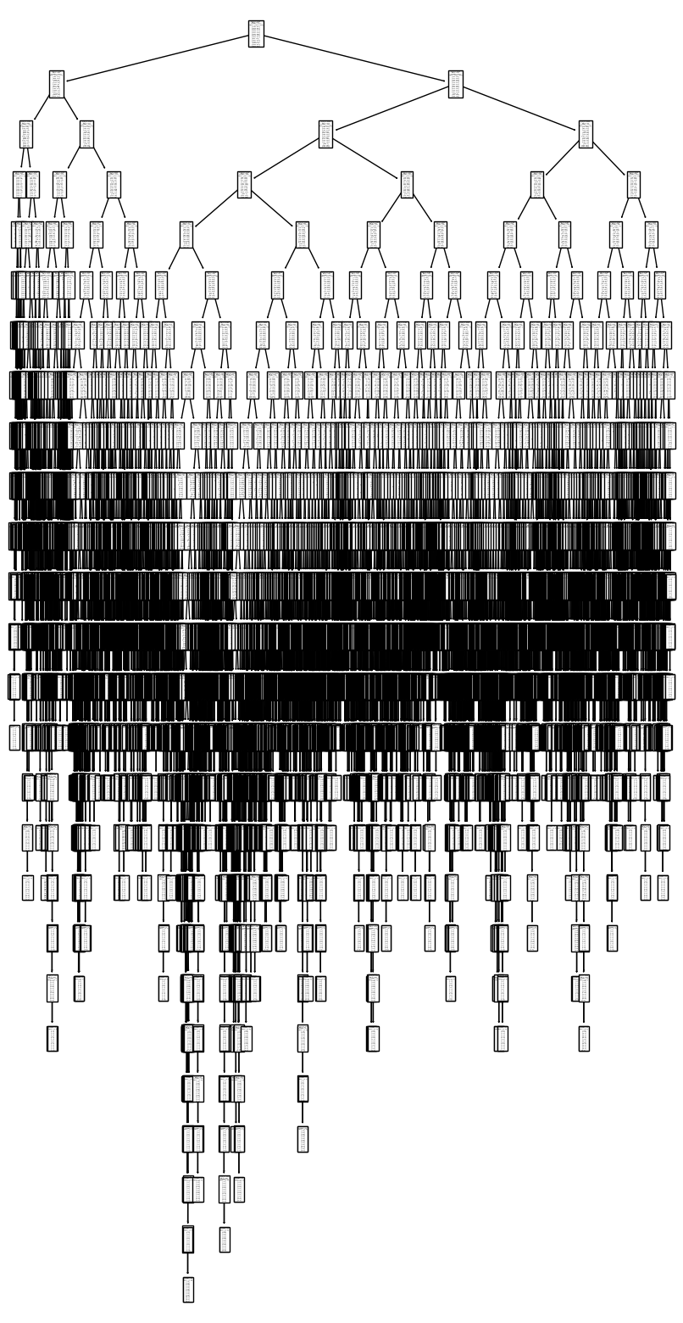
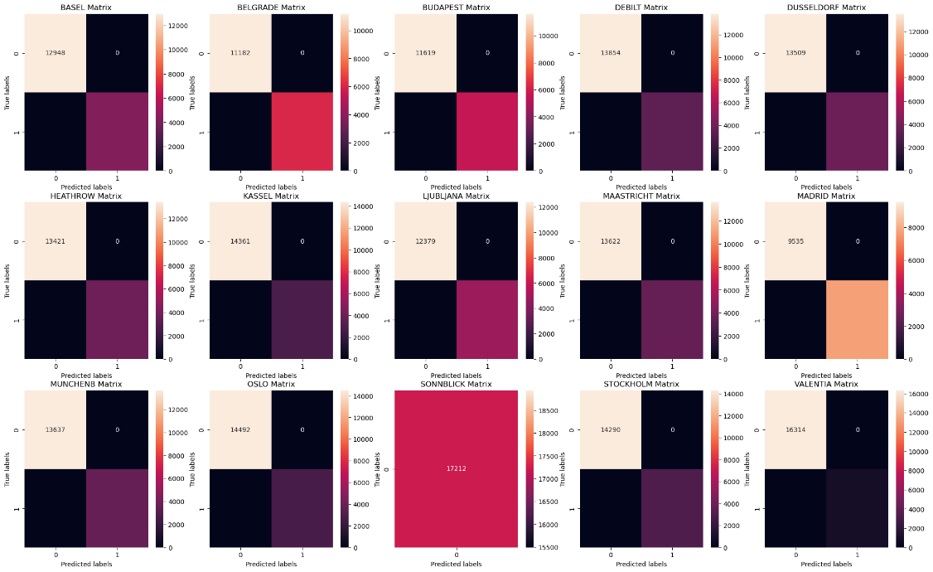
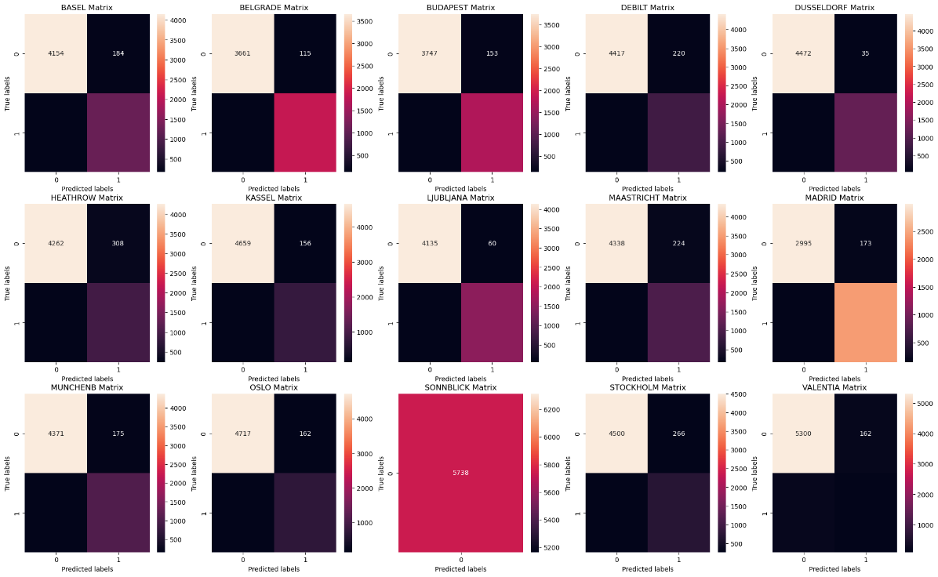
Supervised Learning Methods: Decision Trees
Confusion Matrix Training set
Confusion Matrix Testing set
With little limitations set in advance we get overfitting and will need to prune or start fresh.

Slide 12

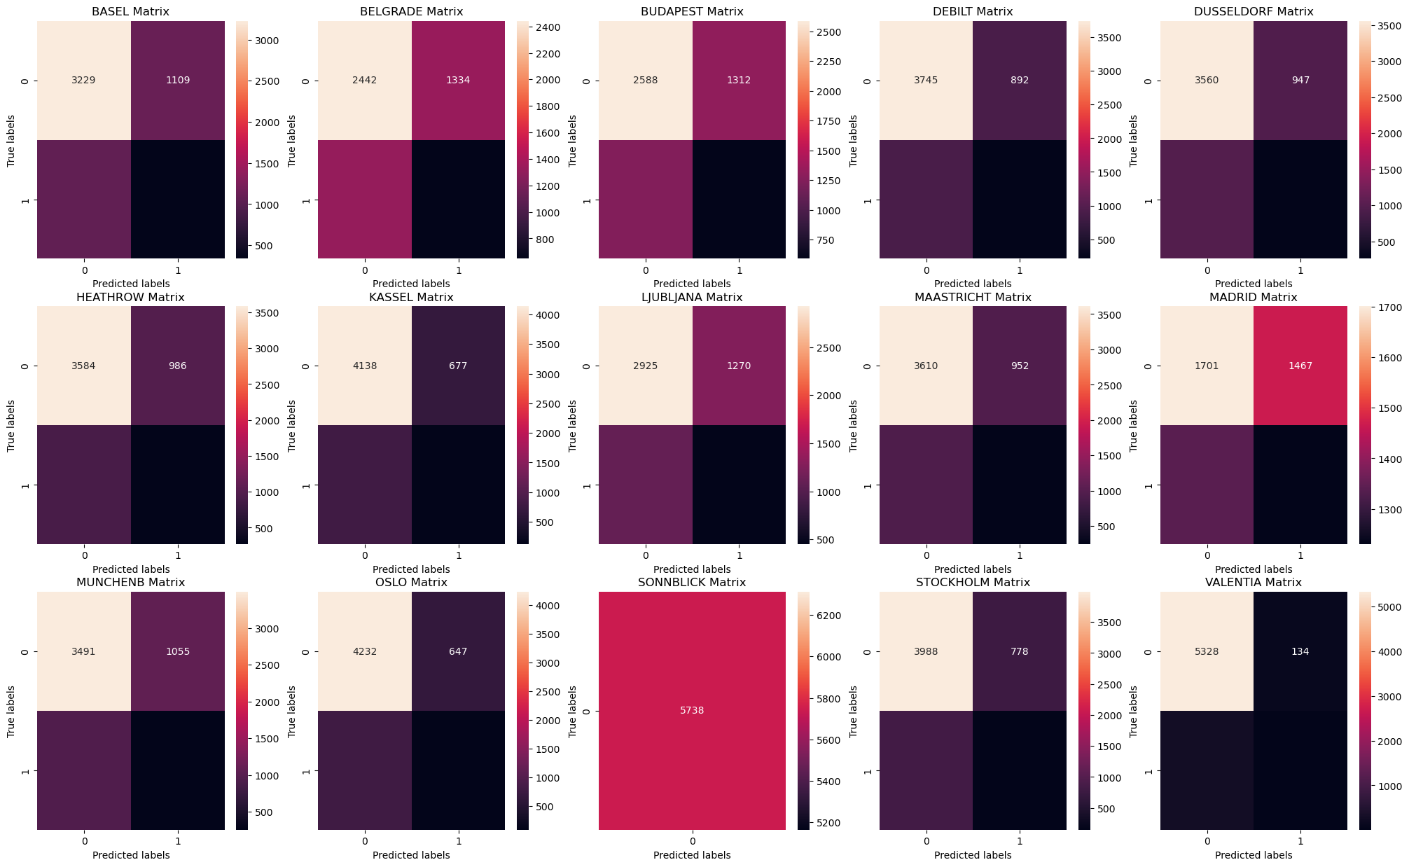
Supervised Learning Methods: ANN
ANN Model 1:
Train Accuracy 58.2%
Test Accuracy 65.2%
- 3 layers (45,35,25) 2700 max iterations tolerance: .000001
Confusion Matrix Training set
Confusion Matrix Testing set

Slide 13
Next steps…
Currently the KNN model is the most accurate, but the Decision Tree model could be improved with pruning and adjusting the model and running again.
The data could benefit from scaling and trimming down the variables that aren’t applicable to all stations for ANN, like snow_depth, sunshine, excluding Sonnblick, possibly excluding Madrid as an outlier at the other end of pleasant weather days.

Slide 14
Thought Questions
What makes weather prediction a good candidate for tackling with machine learning?
How can we avoid human bias entering the analysis process?
Are there other large weather datasets that could complement this analysis?

Slide 15
Thank You!
Tiffany Kinney
tiffkinney@gmail.com

